Slide 1

Exploratory Data Analysis

Slide 2


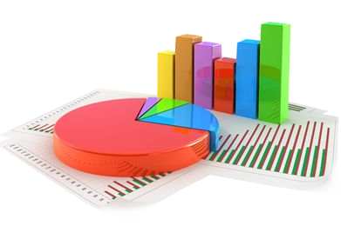

Agenda
01
02
03
What is Exploratory Data Analysis?
.
Why EDA is important?
Visualisation
Important Charts for visualisation
.
04
Steps Involved in EDA:-
Data Sourcing
.
Data Cleaning
Univariate analysis with visualisation
Bivariate analysis with visualisation
Derived metrics
05
Uses Cases

Slide 3

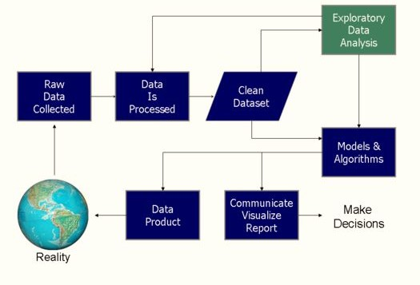
Data Science Process

Slide 4

Exploratory Data Analysis
What is Exploratory Data Analysis?
Exploratory Data Analysis is an approach to analyse the datasets to summarize their main characteristics in form of visual methods.
.
EDA is nothing but an data exploration technique to understand various aspects of the data.
The main aim of EDA is to obtain confidence in a data to an extent where we are ready to engage a machine learning model.

Slide 5

Why EDA is
Important?
EDA is important to analyse the data it’s a first steps in data analysis process.
EDA give a basic idea to understand the data and make sense of the data to figure out the question you need to ask and find out the best way to manipulate the dataset to get the answer of your question.
Exploratory data analysis help us to finding the errors, discovering data, mapping out data structure, finding out anomalies.
Exploratory data analysis is important for business process because we are preparing dataset for deep through analysis that will detect you business problem.
EDA help to build a quick and dirty model, or a baseline model, which can serve as a comparison against later models that you will build.

Slide 6




Visualization
Visualisation is the presentation of the data in the graphical or visual form to understand the data more clearly. Visualisation is easy to understand the data.
Easily analyse the data and summarize it.
Easily understand the features of the data.
Help to find the trend or pattern of the data.
Help to get meaningful insights from the data.

Slide 7
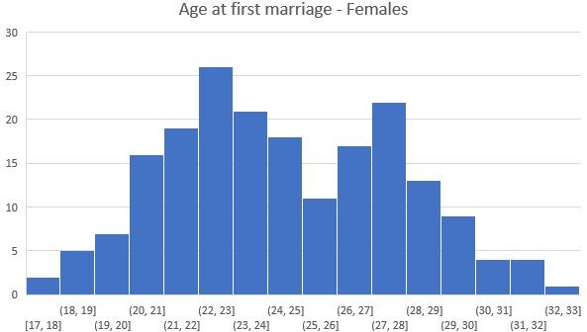

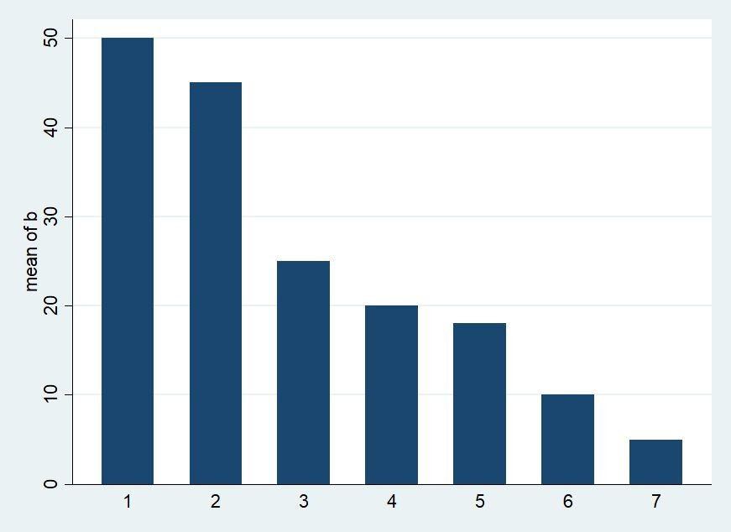
Important Charts for Visualisation
Histogram
Histogram represent the frequency distribution of the data
Bar Chart
Bar graph represent the total observation in the data for a particular category.

Slide 8
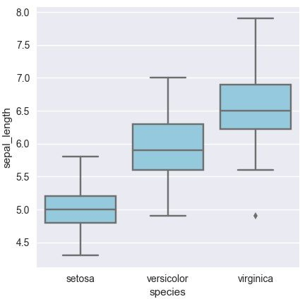
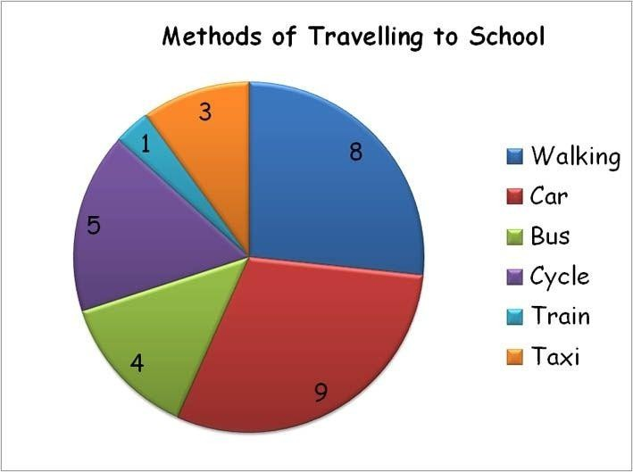
Box Plot
Boxplot display the distribution of the data based on five number summary(minimum, first quartile, median, third quartile, maximum)
Pie Chart
Pie chart represent the percentage of the data by each category.

Slide 9

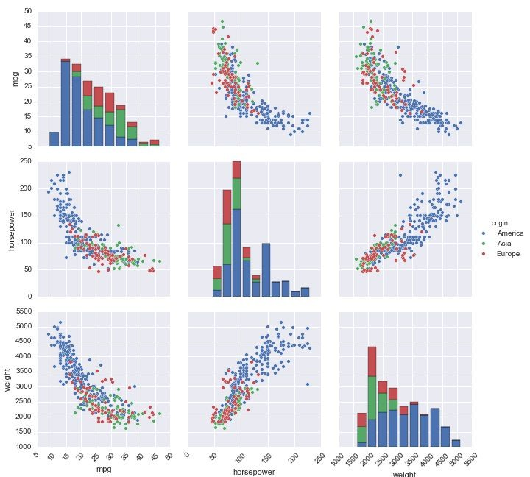

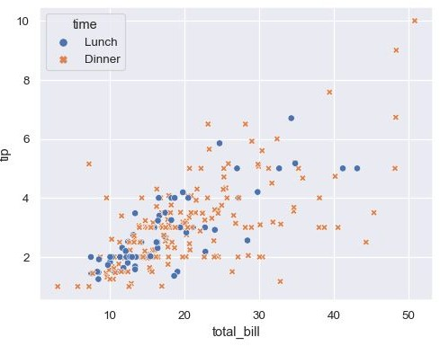
Pair-plot
Pair plot show the bivariate distribution of the datasets. It show the pairwise relationship between the variable
Scatter Plot
Scatter plot represent the relationship between two numerical variable. It show the correlation between two variable.

Slide 10

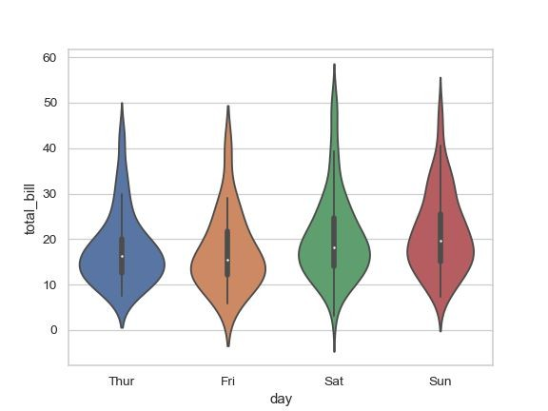

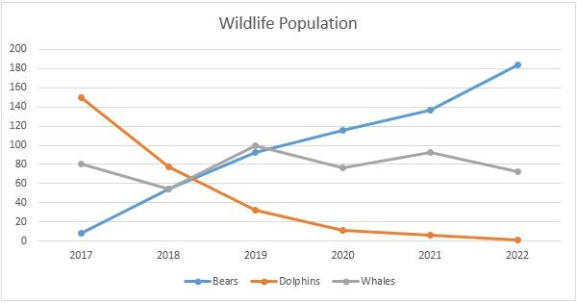
Violin Plot
Violin chart are used to plot numeric data
Line Chart
Line chart are used to track change over line and short period of time. Line chart are used in time series data.

Slide 11
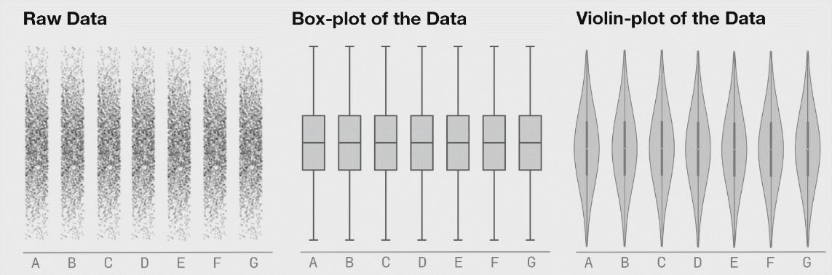
Box Plot vs ViolinPlot
Violin Graphs are better than Box Plots
Violin graph is visually intuitive & attractive.
Image Courtesy: https://blog.bioturing.com/

Slide 12
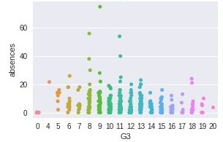

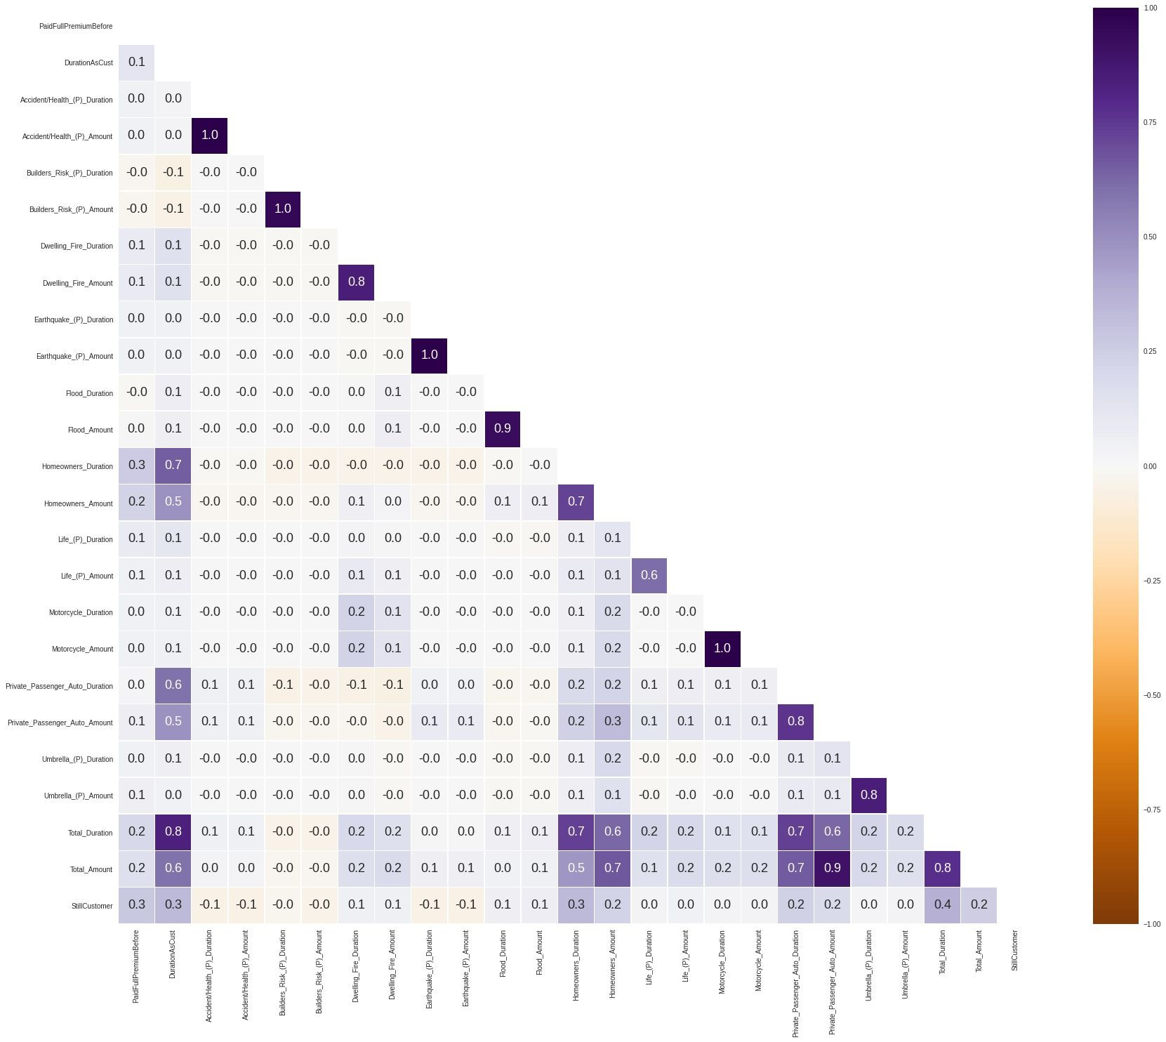
Strip Plot
Strip plots are used to draw a scatter plot for on the categorical basis
Heatmaps
A heat map is data analysis software that uses color the way a bar graph uses height and width.

Slide 13

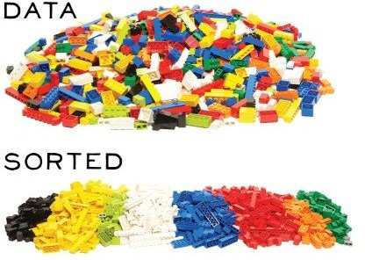

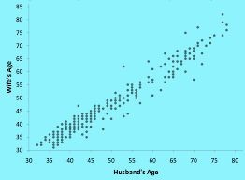

Steps Involved in EDA
01
Data Sourcing
02
Data Cleaning
03
Univariate Analysis with Visualisation
04
Bivariate Analysis with Visualisation
.
05
Derived Metrics

Slide 14
Data
Sourcing
Data Sourcing is the process of gathering data from multiple sources as external or internal data collection.
There are two major kind of data which can be classified according to the source:
1. Public data 2. Private data
Public Data:- The data which is easy to access without taking any permission from the agencies is called public data. The agencies made the data public for the purpose of the research. Like government and other public sector or ecommerce sites made there data public.
Private Data:- The data which is not available on public platform and to access the data we have to take the permission of organisation is called private data. Like Banking ,telecom ,retail sector are there which not made their data publicly available.

Slide 15
Data
Cleaning
After collecting the data , the next step is data cleaning. Data cleaning means that you get rid of any information that doesn’t need to be there and clean up by mistake.
Data Cleaning is the process of clean the data to improve the quality of the data for further data analysis and building a machine learning model.
The benefit of data cleaning is that all the incorrect and irrelevant data is gone and we get the good quality of data which will help in improving the accuracy of our machine learning model.
The following are some steps involve in Data Cleaning:
Handle Missing Values
Standardisation of the data
Outlier Treatment
Handle Invalid values

Slide 16






Some Questions you need to ask yourself about the data before cleaning the data
what you are reading, does it make sense?
.
D. oes this data make sense?
Does this data you’re looking at match the column labels?
.
A.fter compute the summarize statistics for numerical data, does it make sense?
Does the data follow the rules for this. field?

Slide 17
Handle Missing Value
Delete Rows/Columns
This method we commonly used to handle missing values. Rows can be deleted if it has insignificant number of missing value Columns can be delete if it has more than 75% of missing value
Replacing with mean/median/mode
This method can be used on independent variable when it has numerical variables. On categorical feature we apply mode method to fill the missing value.
.
Algorithm Imputation
Some machine learning algorithm supports to handle missing value in the datasets. Like KNN, Naïve Bayes, Random forest.
.
Predicting the missing values
Prediction model is one of the advanced method to handle missing values. In this method dataset with no missing value become training set and dataset with missing value become the test set and the missing values is treated as target variable.
Option A
Option B
Option C
Option D

Slide 18

Example
For Numerical Data
Airlines | Ticket Price
Indigo | 3887
Air Asia | 7662
Jet Airways | -
Air India | 5221
SpiceJet | 4321
Suppose we have Airlines ticket price data in which there is missing value. Steps to fill the numeric missing value:-
Compute the mean/median of the data (3887+7662+5221+4321)/4 = 5272.75
Substitute the Mean of the value in missing place.
For categorical Data
Airlines | Ticket price
Suppose we have Missing values in the categorical data:
Then we take the mode of the dataset a to fill the missing values: Here :
Mode = Indigo
We substitute the Indigo in place of missing value in Airline column.

Slide 19

Standardization/ Feature Scaling
Feature scaling is the method to rescale the values present in the features. In feature scaling we convert the scale of different measurement into a single scale. It standardise the whole dataset in one range.
Importance of Feature Scaling:- When we are dealing with independent variable or features that differ from each other in terms of range of values or units of the features, then we have to normalise/standardise the data so that the difference in range of values doesn’t affect the outcome of the data.

Slide 20
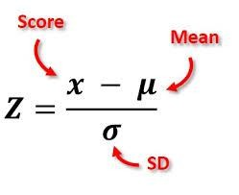
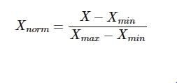
Feature Scaling Technique
Standard Scaler
Standard scaler ensures that for each feature, the mean is zero and the standard deviation is 1,bringing all feature to the same magnitude. In simple words Standardization helps you to scale down your feature based on the standard normal distribution
Standardization
.
Normalization
Min-Max Scaler
Normalization helps you to scale down your features between a range 0 to 1

Slide 21

Example
Normalisation
Age | Income (£) | New value
24 | 15000 | (15000 – 12000)/18000 = 0.16667
30 | 12000 | (12000 – 12000)/18000 =0
28 | 30000 | (30000 – 12000)/18000 =1
Income Minimum = 12000 Income Maximum = 30000
(Max – min) = (30000 – 12000) = 18000
Hence, we have converted the income values between 0 and 1 Please note, the new values have
Minimum = 0
Maximum = 1
Standardization
Average = (15000 + 12000 + 30000)/3 = 19000
Standard deviation = ??
Age | Income (£) | New value of Income
24 | 15000 | (15000 - 19000)/std = ??
30 | 12000 | (12000 - 19000)/std = ??
28 | 30000 | (30000-19000)/std = ??

Slide 22

Outlier Treatment
Outliers are the most extremes values in the data. It is a abnormal observations that deviate from the norm. Outliers do. not fit in the normal behaviour of the data.
Detect Outliers using following methods:
1.Boxplot 2. Histogram 3. Scatter plot
4.Z-score
5. Interquartile range(values out of 1.5 time of IQR)
Handle Outlier using following methods:-
Remove the outliers.
Replace outlier with suitable values by using following methods:-
  Quantile method
  Interquartile range
Use that ML model which are not sensitive to outliers Like:-KNN,Decision Tree,SVM,NaïveBayes,Ensemble
methods

Slide 23

Encode Unicode properly:-In case the data is being read as junk
Handle Invalid Value
characters, try to change encoding, E.g. CP1252 instead of UTF-8.
Convert incorrect data types:- Correct the incorrect data types to the correct data types for ease of analysis. E.g. if numeric values are stored as strings, it would not be possible to calculate metrics such as. mean, median, etc. Some of the common data type corrections are — string to number: "12,300" to “12300”; string to date: "2013-Aug" to “2013/08”; number to string: “PIN Code 110001” to "110001"; etc.
Correct values that go beyond range:- If some of the values are beyond logical range, e.g. temperature less than -273° C (0° K), you would need to correct them as required. A close look would help you check if there is scope for correction, or if the value needs to be removed.
Correct wrong structure:- Values that don’t follow a defined structure can be removed. E.g. In a data set containing pin codes of Indian cities, a pin code of 12 digits would be an invalid value and needs to be removed. Similarly, a phone number of 12 digits would be an invalid value

Slide 24




Univariate Analysis
Univariate analysis deal with analysing one feature at a time. Univariate analysis is important to understand the single variable at a time. The main purpose of univariate analysis is to make data easier to interpret.
Mainly, Histogram is used to visualize univariate
Univariate Types:
Frequency
Measure of frequency include frequency table, where you tabulate how often a particular category or particular value appear in the dataset.
.
It is a typical value for a probability distribution for
univariate measure of central tendency we have Mean, Median, Mode.
.
It tries to capture how your data points jump around.
Central Tendency
Dispersion

Slide 25







Types of Data
Qualitative
Quantitative
A variable which able to describe quality of the population.(Numerical values
A variable which quantify the population(distinct categories)
Nominal
Ordinal
Discrete
Continuous

Slide 26


Types of Data
Discrete
It has a discrete value that means it
Nominal
It represent qualitative information
.
take only counted value not a
of
without order. Value represent a
decimal values. Like count student in class
discrete units.
Like Gender: Male/Female ,Eye colour.
Continuous
A number within a range of a value is usually measured, such as height.
Ordinal
It represent qualitati.ve information with order. It indicate the measurement classification are different and can be ranked. Lets say Economic status: high/medium/low which can ordered as low,medium,high.

Slide 27

Segmented Univariate Analysis
.
Segmented Univariate Analysis allow you to compare subset of data it help us to understand how the relevant metric varies across the different segment.
The Standard process of segmented univariate analysis is as follow:
Take a raw data
Group by dimensions
Summarise using a relevant metric like mean
,median.
Compare the aggregate metric across the categories.

Slide 28


BivariateAnalysis
Data which has two variables ,you often want to measure the relationship that exists between these two variables.
Bi-variate Types:
Correlation measure the strength as well as the direction of the linear relationship between the two variables. Its range is from -1 to +1.
Correlation
If one increases as the other increases, the correlation is positive
If one decreases as the other increases, the correlation is negative
If one stays c.onstant as the other varies, the correlation is zero
.
Covariance measure how much two random
variable vary together. Its range is from -∞ to +∞.
Covariance

Slide 29

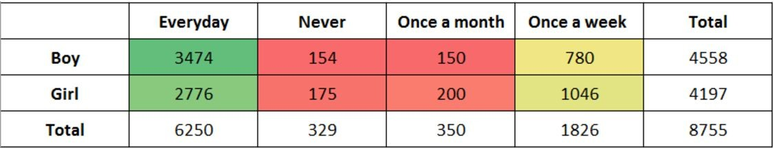
Example
To see the distribution of two categorical variables. For example, if you want to compare the number of boys and girls who play games, you can make a ‘cross table’ as given below:
To see the distribution of two categorical variables with one continuous variable. For example, you saw how a student’s
percentage in science is distributed based on the father’s occupation (categorical variable 1) and the poverty level (categorical variable 2).

Slide 30



Derived Metrics
Derived metrics create a new variable from the existing variable to get a insightful information from the data by analysing the data.
Feature Binning
Feature Encoding
From Domain Knowledge
Calculated from Data

Slide 31

Feature Binning
.
Feature binning converts
variable
or transform to categorical
continuous/numeric
variable. It can also be used to identify missing values or outliers.
Type of Binning:-
Unsupervised Binning
  Equal width binning
  Equal frequency binning
Supervised Binning
  Entropy based binning

Slide 32
Equal Width
Equal width separate the continuous variable to several categories having same range of width.
Un Supervised Binning
It transform continuous or num. eric variable into categorical value without taking dependent variable into consideration
Equal Frequency
Equal frequency separate the continuous variable into several categories having approximately same number of values.
Entropy Based
Entropy based binning separate the continuous or numeric variable majority of values in a category belong to same label of class.
Supervised Binning
It transform continuous or numeric variable into categorical value taking dependent variable into consideration.
.

Slide 33



Feature Encoding
Feature encoding help us to transform categorical data into numeric data.
Label encoding
Label encoding is technique to transform categorical variables into numerical variables by assigning a numerical value to each of the categories.
One-Hot encoding
This technique is used when independent variables are nominal. It creates k different columns each for a category and replaces one column with 1 rest of the columns is 0.
Target Encoding
In target encoding, we calculate the average of the dependent variable for each category and replace the category variable with the mean value
Hash Encoder
TheHashencoder represents categorical independent variable using the new dimensions. Here, the user can fix the number of dimensions after transformation using component argument.

Slide 34

Uses Cases
Basically EDA is important in every business problem, it’s a first crucial step in data analysis process.
Some of the use cases where we use EDA is:-
Cancer Data Analysis :- In this data set we have to predict who are suffering from cancer and who’s not.
Fraud Data Analysis in E-commerce Transactions :- In this dataset we have to detect the fraud in a E-commerce transaction.
Uses Cases

Slide 35



THANK YOU

